Slide 1


Music Recommendation System
Meditation & Relaxation
P-92
Group No. 6
Group Members-
Samyuktha Patnaik
Amruta Kulkarni Deshpande
Pragati Dnyaneshwar Patel
Ruchika Sanjay Aglawe
Kedar Sanjay Chougule
Suraj Yallappa Takkekar
Pooja Pratapsingh Basutiya

Slide 2
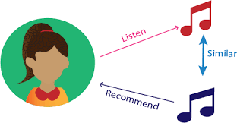
Music Recommendation System
Music dataset is too big while life is short!!!! You need someone to teach you how to manage and give you wise suggestions according to your taste!
Music service providers need a more efficient system to attraction their clients!
By using music recommender system, the music provider can predict and then offer the appropriate songs to their users based on the characteristics of the music that has been heard previously.

Slide 3

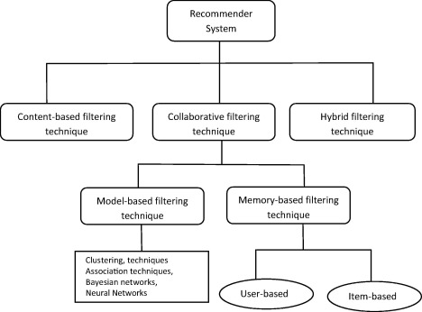
Types of Recommendations Systems

Slide 4
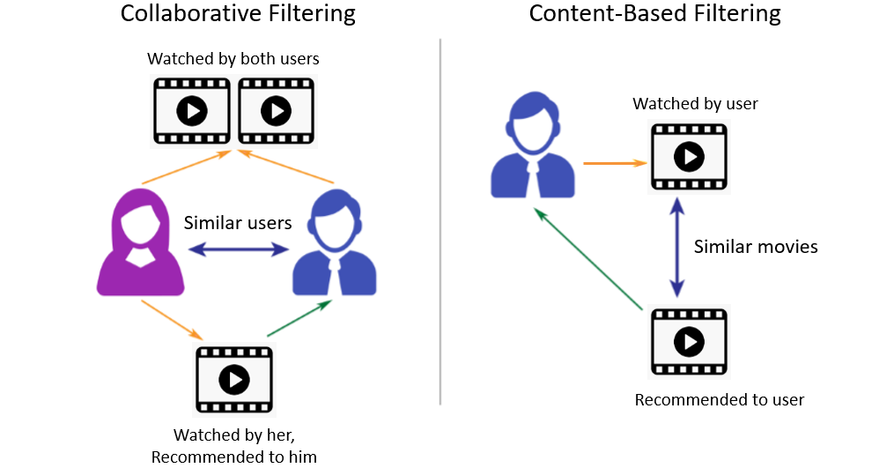
Collaborative VS Content Based Flitering

Slide 5
Content Based Model
Content-based filtering is one popular technique of recommendation or recommender systems. The content or attributes of the things you like are referred to as "content."
Here, the system uses your features and likes in order to recommend you with things that you might like. It uses the information provided by you over the internet and the ones they are able to gather and then they curate recommendations according to that.
The goal behind content-based filtering is to classify products with specific keywords, learn what the customer likes, look up those terms in the database, and then recommend similar things.

Slide 6
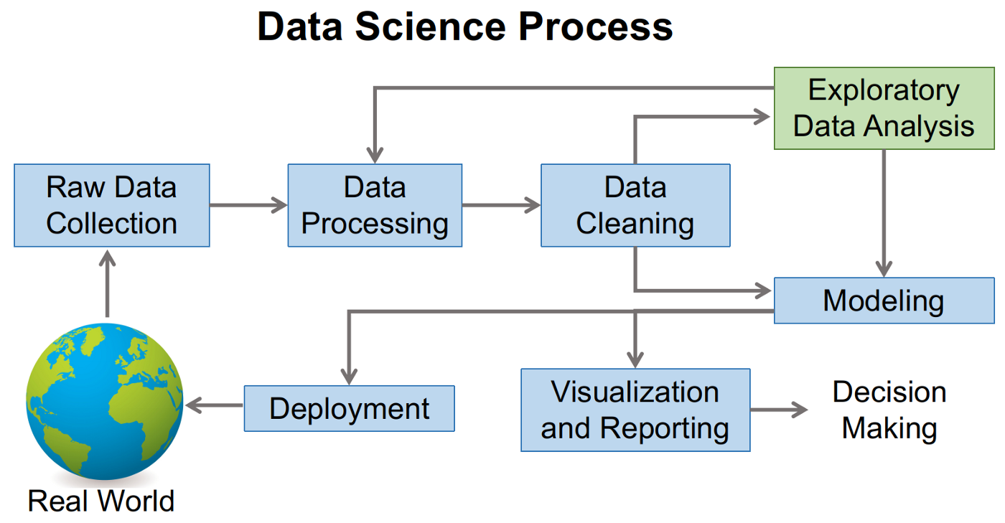
Flowchart

Slide 7
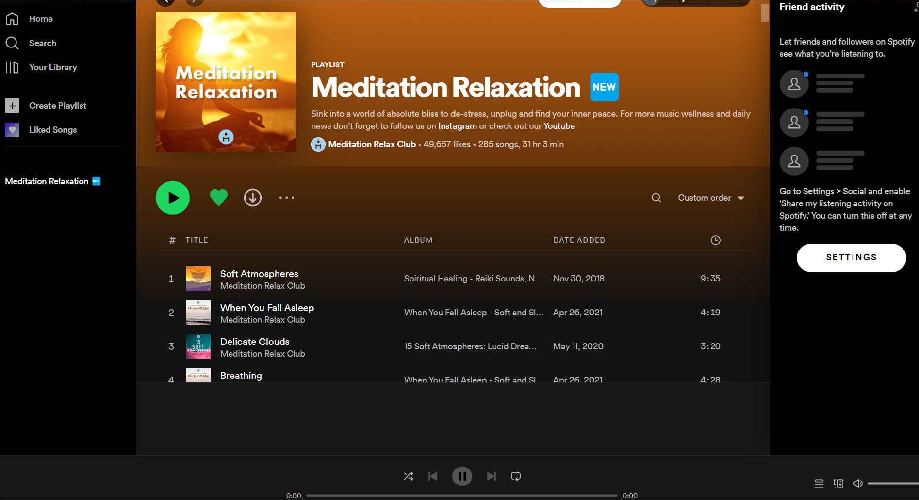
Dataset
Created a playlist in Spotify app
Extracted Spotify Playlist Tracks

Slide 8
Understanding the Features
In this dataset, we have 23 columns:
user_id: spotify users unique id
Track Name: Name of the track
Artist Name(s): Artist name of the track
Album Name: Track belongs to this album name
Album Release Date: Releasing date of album
Track Number: Unique track number of each song track
Track Duration (ms):Duration of each song track
Explicit:The explicit logo is applied when the lyrics or content of a song or a music video contain one or more of the following criteria which could be considered offensive or unsuitable for children
Popularity: For how many times song has been played
Added By: who added the track in playlist
Added At: Time at which a song added to the playlist
Danceability: it measure describes how suitable a track is for dancing
Energy: represents a perceptual measure of intensity and activity.
Key: the track is in. Integers map to pitches using standard Pitch Class notation. Valence measures from 0.0 to 1.0 describing the musical positiveness conveyed by a track
Loudness: Loudness of a track in decibels(dB).
Mode: Mode indicates the modality(major or minor) of the song
Speechiness: Speechiness detects the presence of spoken words in a track
Acousticness: Acosticness confidence measure from 0.0 to 1.0 of whether the track is acoustic
Instrumentalness: Instrumentalness predicts whether a track contains vocals or not
Liveness: it detects the presence of an audience in the recording
Valence: A measure from 0.0 to 1.0 describing the musical positiveness conveyed by a track
Tempo: Tempo is in beats per minute (BPM)
Time Signature: it is an estimated overall time signature of a track

Slide 9

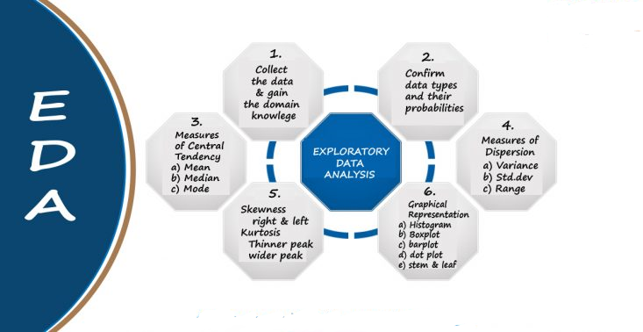
Complete Understanding of EDA

Slide 10

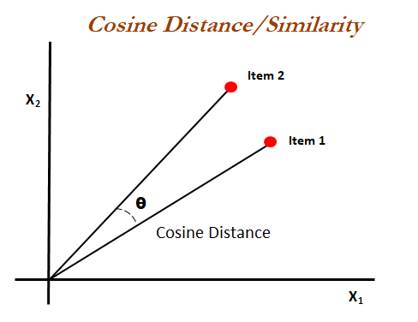
Item Similarity
The cosine similarity measures the similarity between vector lists by calculating the cosine angle between the two vector lists.
If you consider the cosine function, its value at 0 degrees is 1 and -1 at 180 degrees. This means for two overlapping vectors, the value of cosine will be maximum and minimum for two precisely opposite vectors.
from sklearn.metrics.pairwise import cosine_similarity,cosine_distances

Slide 11


Deployment
Deployment is the mechanism through which applications, modules, updates, and patches are delivered from developers to users.
The methods used by developers to build, test and deploy new code will impact how fast a product can respond to changes in customer preferences or requirements and the quality of each change.
Streamlit is an app framework to deploy machine learning apps built using Python. you can immediately deploy your project using Streamlit Sharing

Slide 12
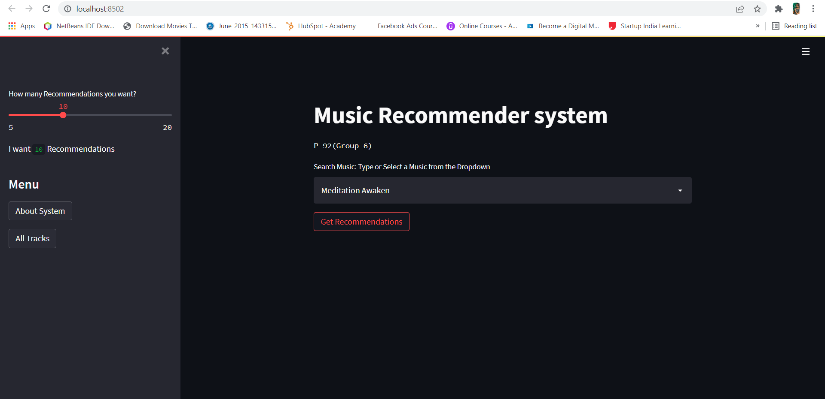
Webpage

Slide 13
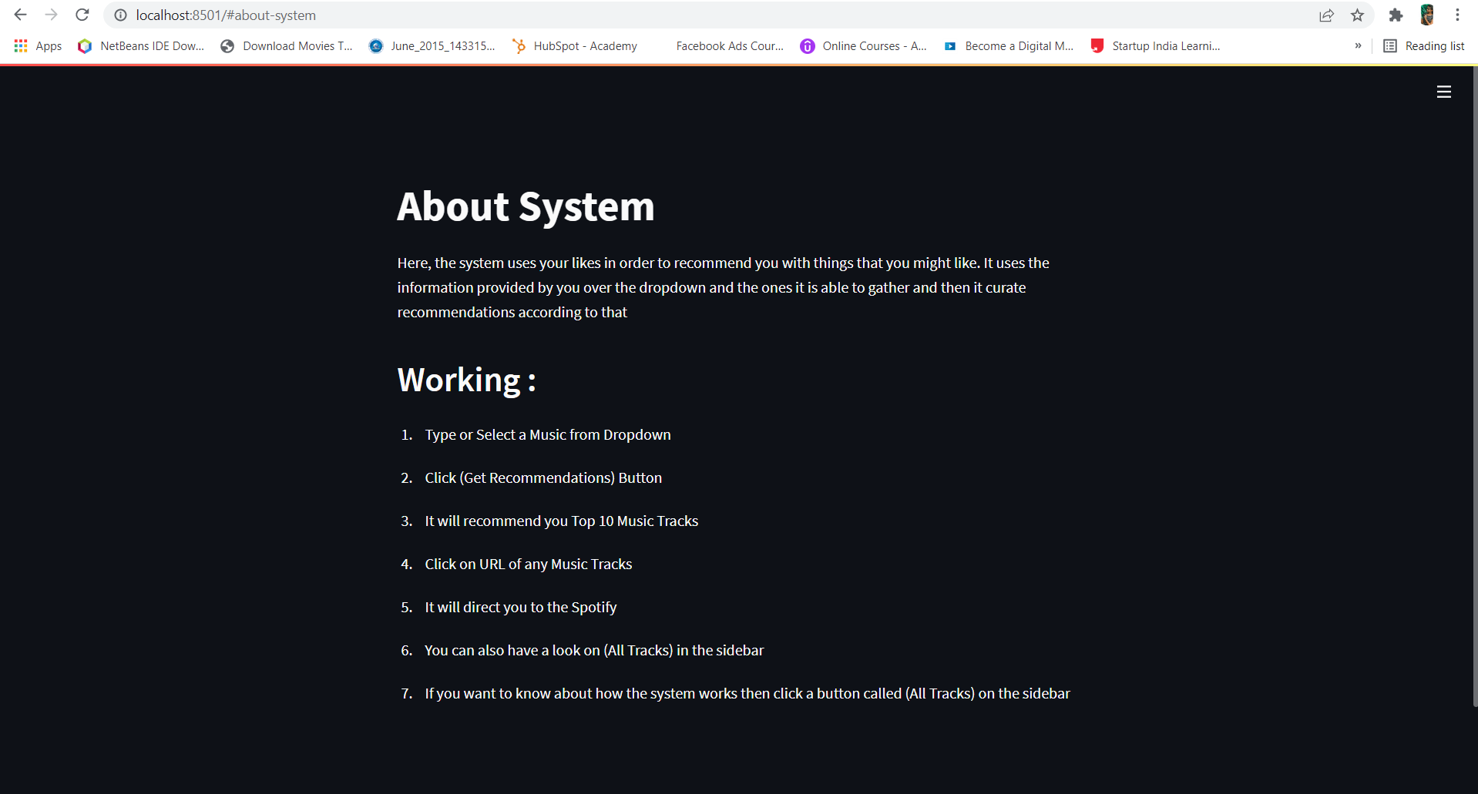
About & Working of Webpage

Slide 14
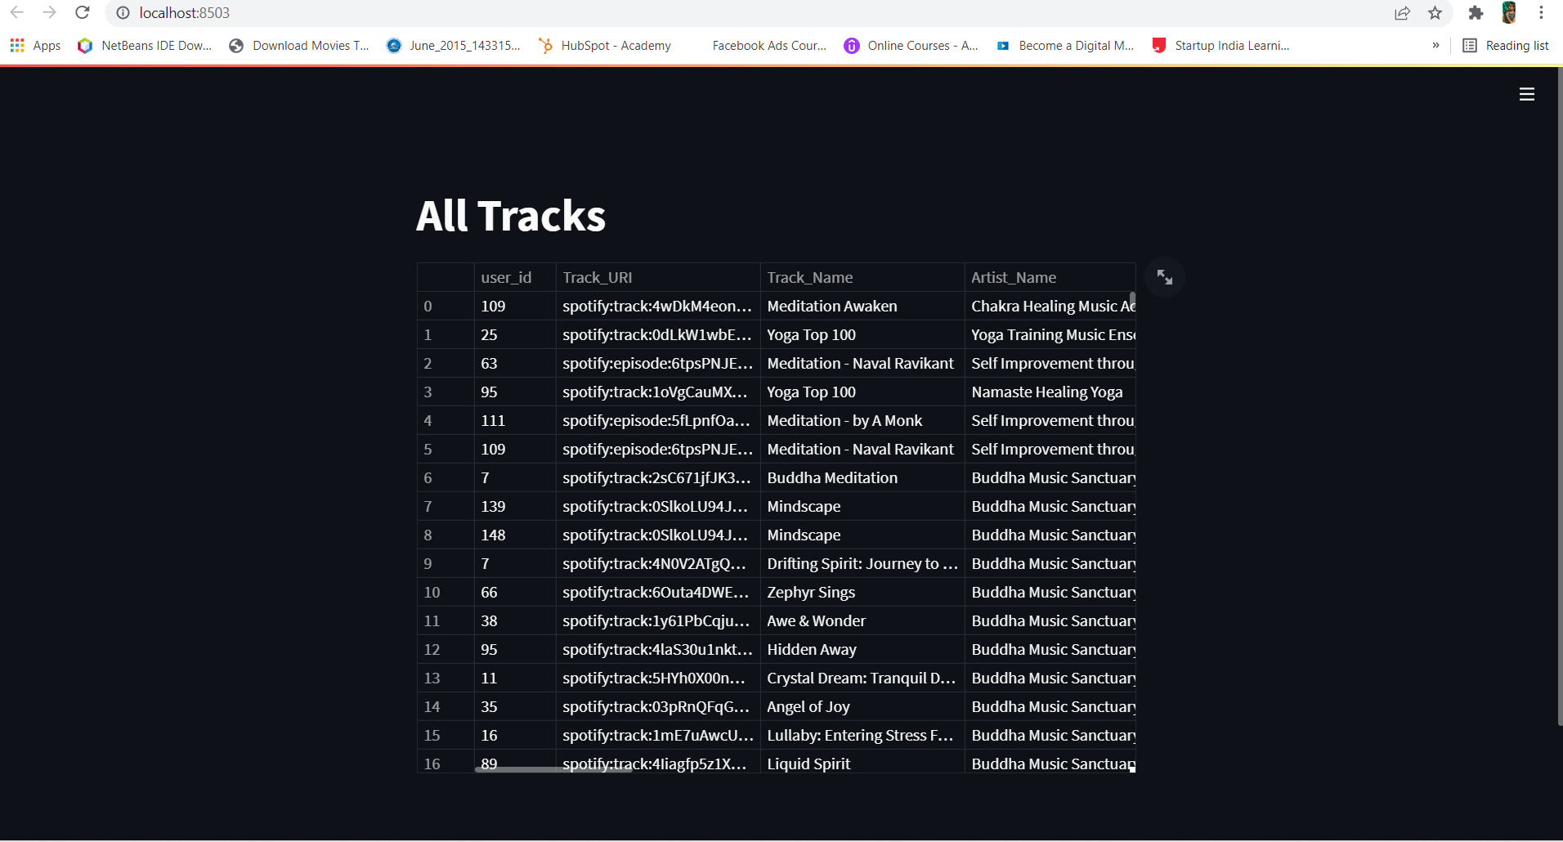
All Tracks

Slide 15


